Slide 1
Binary Translation and Optimization - 046275
Majd Abdo 207930660
Abed Alhalem Kadi 206624603

Slide 2
Introduction
- In this project we optimized our code using two methods:
Function inlining and code reordering. in hope to get better
performances.

Slide 3
Profiling
In this project we had 2 profiling:
1- profiling for code recording.
2- profiling for function inlining.

Slide 4
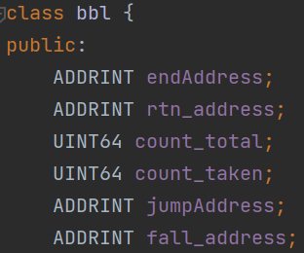
Data Structures and profiling- code reordering
1. Collecting information for code reordering:
bbl info:
- bbl end address
- bbl count count
- bbl’s routine address
- bbl count taken
- bbl jump address
- bbl fall address

Slide 5
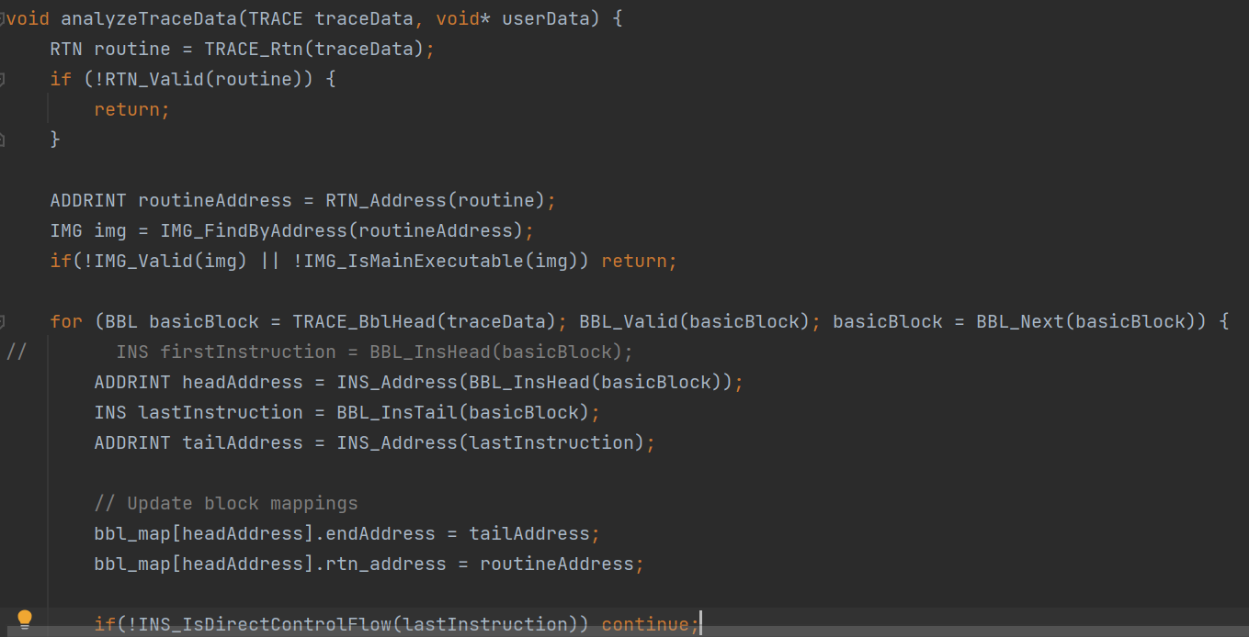
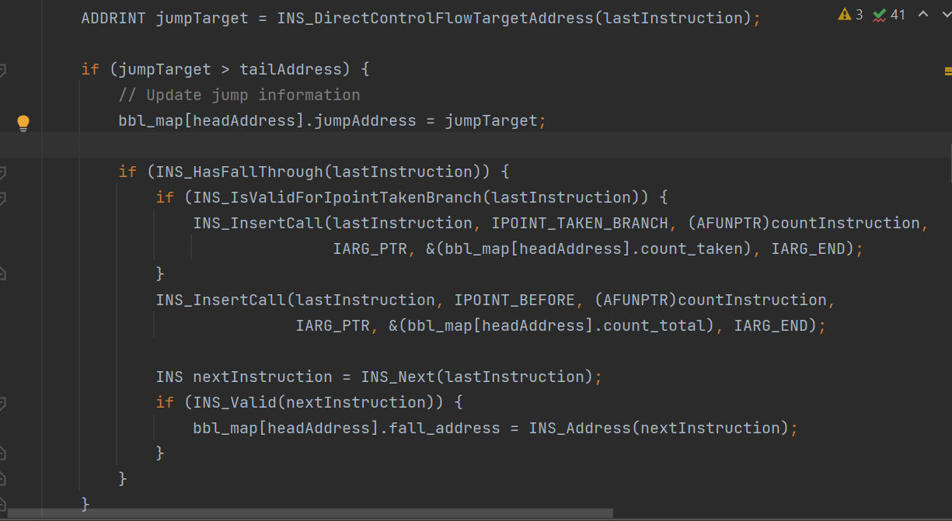
Data Structures and profiling- code reordering

Slide 6
Data Structures and profiling- code reordering
- we defined a map called bbl_map and in the function analyzeTraceData that we showed above we collected all the information we need for each bbl by iterating through the bbls inside the trace.

Slide 7
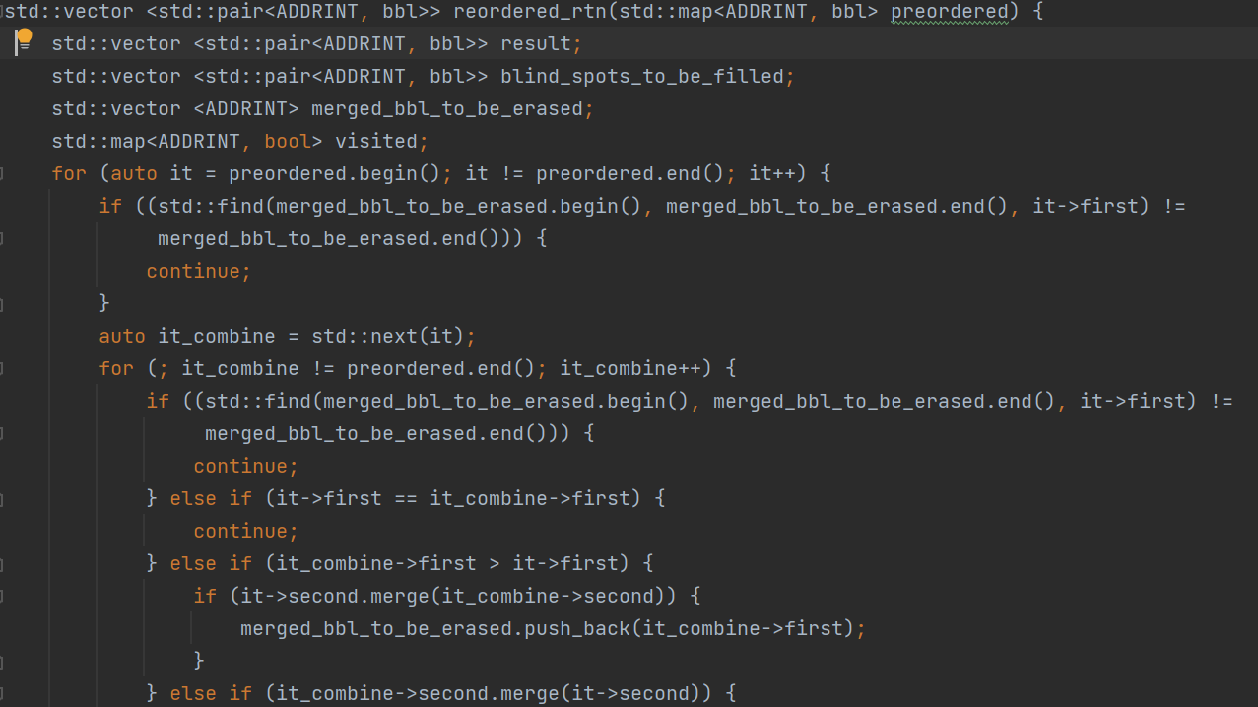
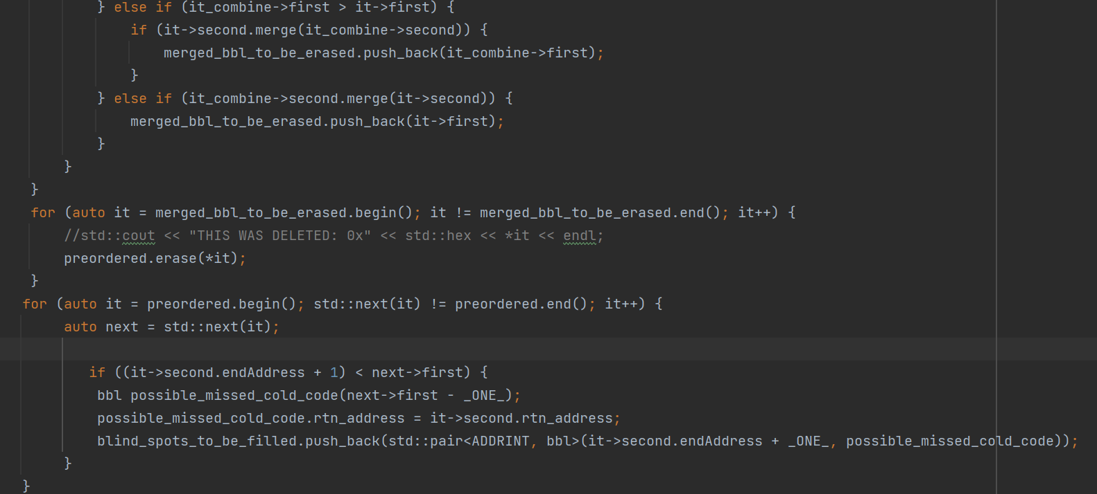
Data Structures and profiling- code reordering

Slide 8
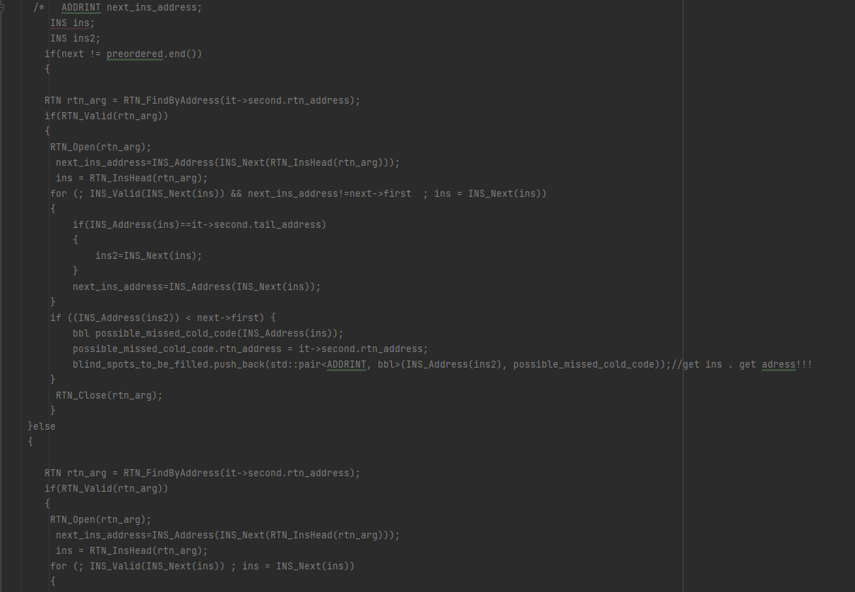
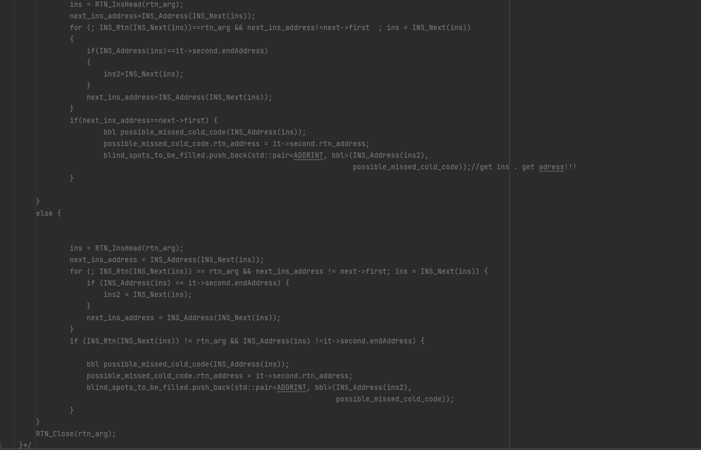
Data Structures and profiling- code reordering

Slide 9
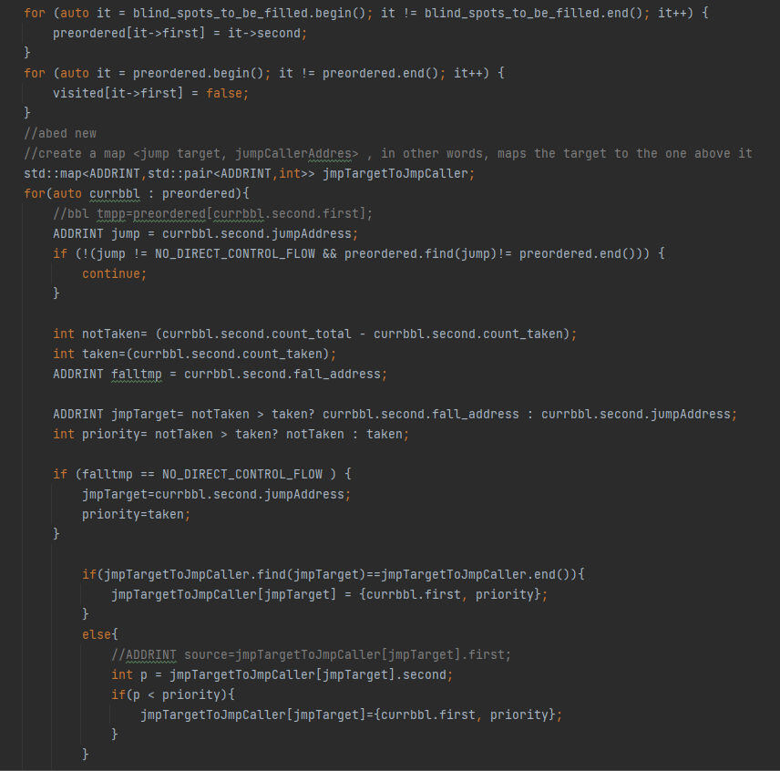
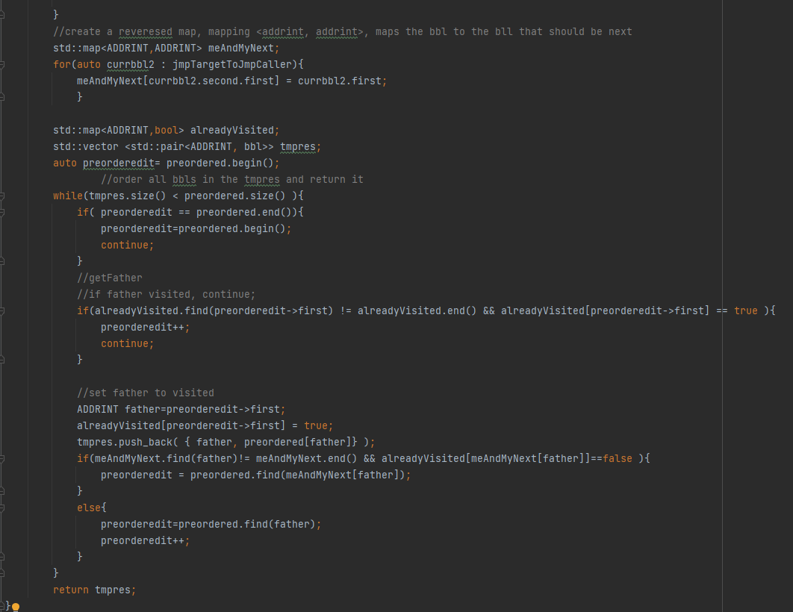
Data Structures and profiling- code reordering

Slide 10
Data Structures and profiling- code reordering
- This function takes a map of bbls for each routine then checks if there is intersection and if there is we merge the two bbls to create a combined one.
-This function also add the code that we didn’t collect during the trace to a new bbl
- then we reorder the bbls according to the new order that we want.

Slide 11
Data Structures and profiling- inlining
- we gathered info regarding each routine and it‘s call sites to preform inlining according to it.
- We have collected data on the number of times we reached each call site for every routine.
- Our printed call sites are subject to a threshold set at 0.6 within our context.
- we have filtered out call sites that were accessed only one time or less.
- we counted the number of times we reached each call site using a map and the address of the caller and callee.
- Ultimately, for each routine, we have selected a single call site only if it constitutes more than 0.6 of the total calls, otherwise we didn‘t print any data for this routine.
- For each routine and site we check if it‘s valid for inlining in the opt part.

Slide 12
Optimization
In this part we got 2 main parts:
1- committing the inilined functions in the desired place in the routine.
2- committing the bbls of the routine in the desired order.

Slide 13
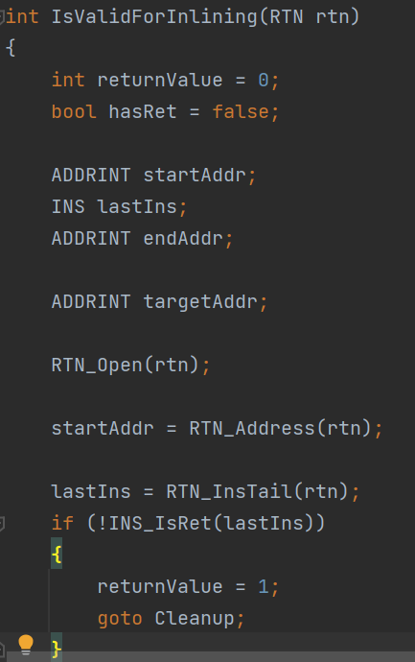
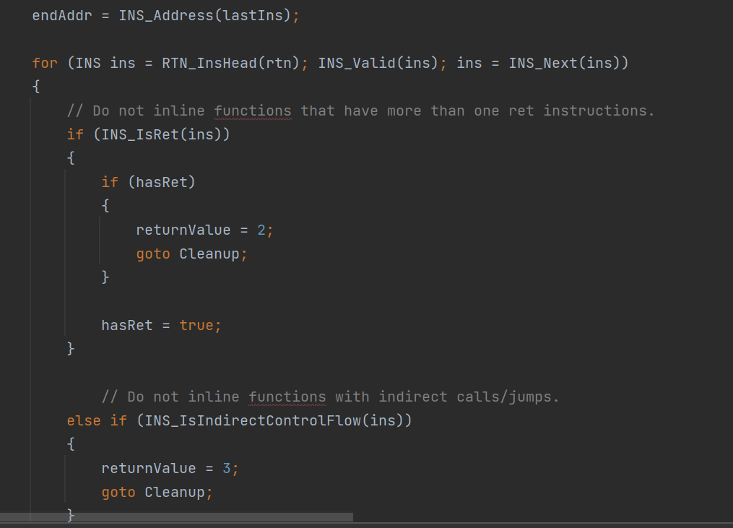
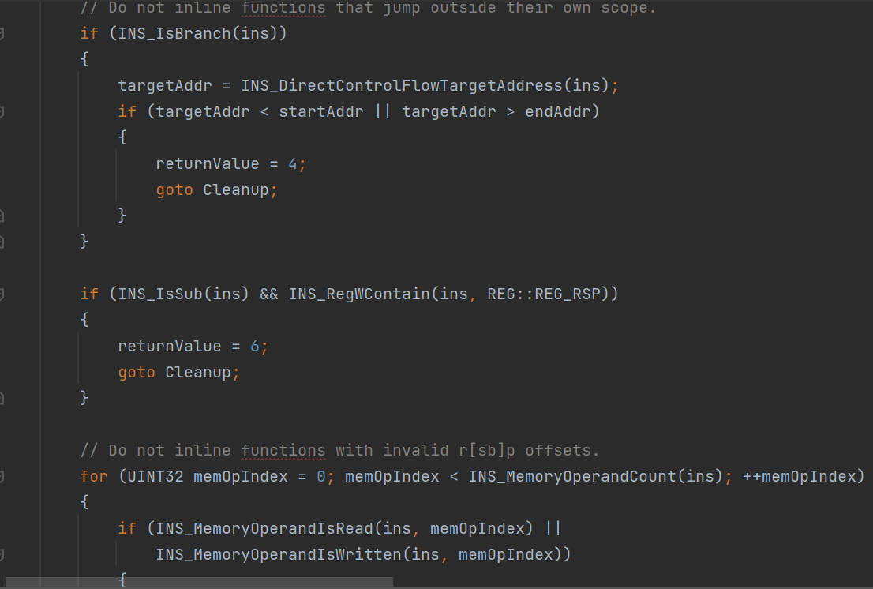
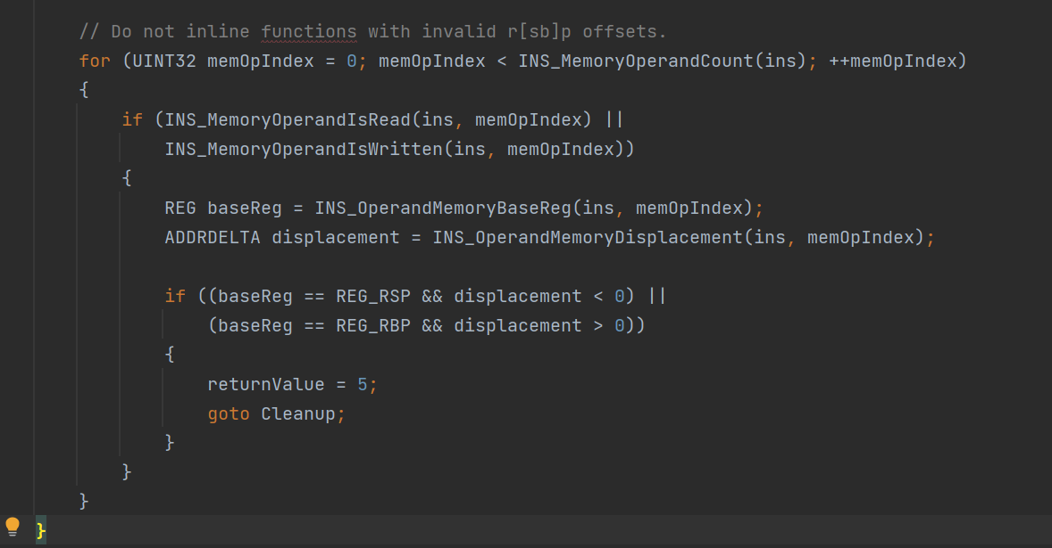
Checking if inline candidate

Slide 14
Checking if inline candidate
In this function we checked if the function is valid for inlining by:
- checking the rsp and rbp register
- checking if the function has more than one ret
- checking if the function has a call in it

Slide 15
Committing inlined functions
During the process of adding each instruction to the instr_map_t within the function " add_rtn_to_inst_map_2" when we encounter a call site, we check to determine if it qualifies as an inline candidate. If it does meet the criteria, we call " add_rtn_to_inst_map_2 " with the target address of the call target address, thereby establishing a chain of the callee function's instructions rather than the call itself. Finally, we decrement "tc_cursor" by 1 to Ignore the "ret" instruction.

Slide 16
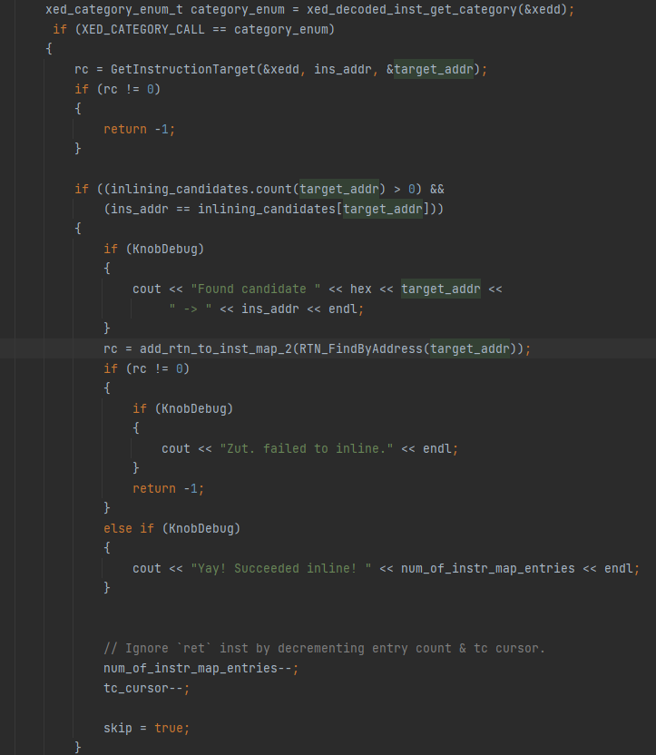
Committing inlined functions
Here we can see the code of the process that we explained above:

Slide 17
Committing bbls
For every rtn, we commit each basic block to the instr_map_t for it to be commeted in the translation cache. To ensure the accurate functioning of our code, we need to make slight adjustments for each basic block's conclusion. We encounter three primary scenarios:
1- If the next basic block in the updated order corresponds to the next block in the original order, we leave the block unaltered and commit it without modifications.
2- If the next basic block in the new order serves as the target of the conditional branch, we invert the condition and modify the target address to match the address of the fall-through basic block in the original order.
3- If the next block doesn't represent the fall-through basic block or the target basic block, we maintain the branch's condition unchanged but add a new jump instruction at the block's end,to the original fall-through address.

Slide 18
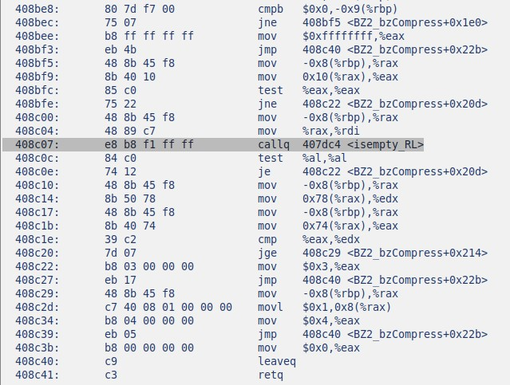
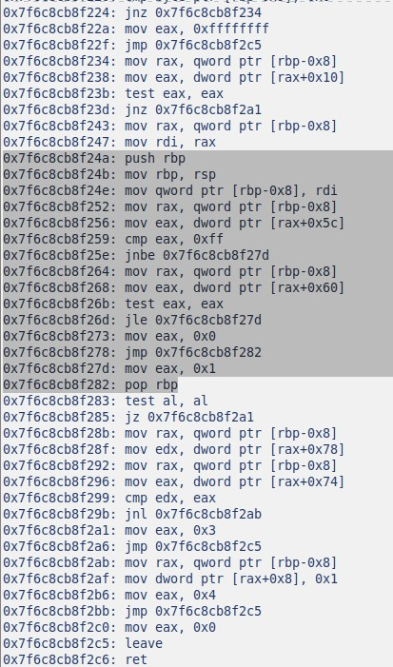
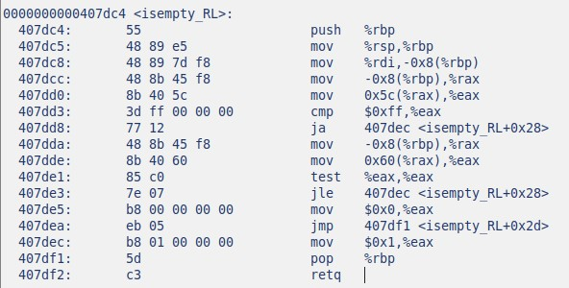
Examples – inline

Slide 19
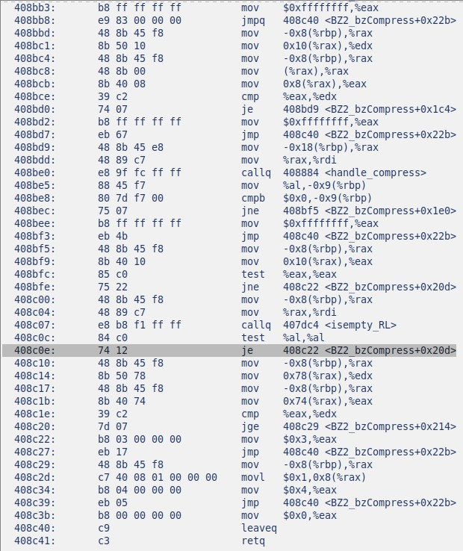
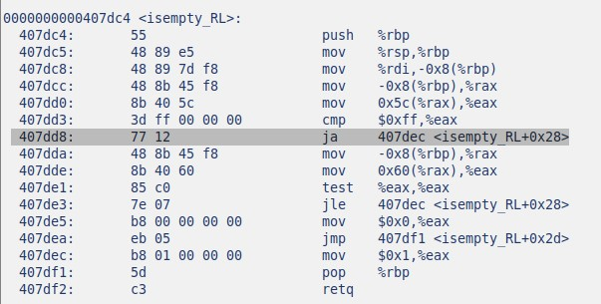
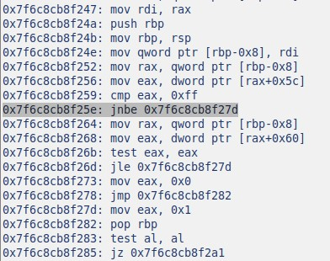
Examples – reordering

Slide 20
Challenges
We faced a lot of challenges doing this project but the most challenging were:
1- writing an algorithm to reorder the bbls, this was by far the hardest challenge we faced because we wanted to find the most optimal algorithm to gain maximum performance and it costed us a lot of time and work.
2- trying to inline all of the routines.
3-limited information and misleading help by chat gpt.

Slide 21
Performances
- Unfortunately we did not see any notable performance gains but at least we didn’t decrease performances .
- As seen in the examples we did manage to preform right reordering and inlining so theoretically we should have seen some performance gains.
- we manage to run bzip2 successfully.

Slide 22
Summary
- A very challenging project to say the least, we spent hours upon hours working on this project, although it consumed a lot of our powers the feel of relief and joy after we finished was amazing especially because we managed to complete the challenging part of this project.
- We have a much better understanding of the course
-We gained a lot of knowledge working with the pintool and maybe it will come back and helps us in the future.

